Slide 1
Package=TestNGupgrade
1) Parent class( Testbase.upgradeJava)
Web driver Driver =New chrome driver()
maximize Window()
Pageloadtime()
Implicit wait()
Delete allcookies()
Geturl()
Page object model is a design pattern + approach+ Data driven framework+ TestNG
2) Page layer with all the classes for each page
Clickonsigninlink()
Fillpagefrom()
Click submit()
Package =Com.upgrde qa.Environment
Check your rate page
Web objects/Elements(Oreps)
2)Actions/Methods-features(
4) Environmental variables
Config.properties
Url,username,Password
Broswer,others
3) Test Layers in Test NG
Personal information
Package = Com.upgrade.qa.data
Login Tests
5) Test data.xls(apache poi)
Loan eligibility page
Basicinfo tests
Text validation test
Package = Com.upgrade.qa.testutil
Sign in page
Signout tests
6)Testutil.Java
Screenshots()
Send mail()
Commonutils()
Genericfunctions()
Check your rate test
upgrade.qa.tests
Package =Com.upgrade.qa.reports
7)Test report: pass/fail
lHTML
TestNG
XML reports

Slide 2
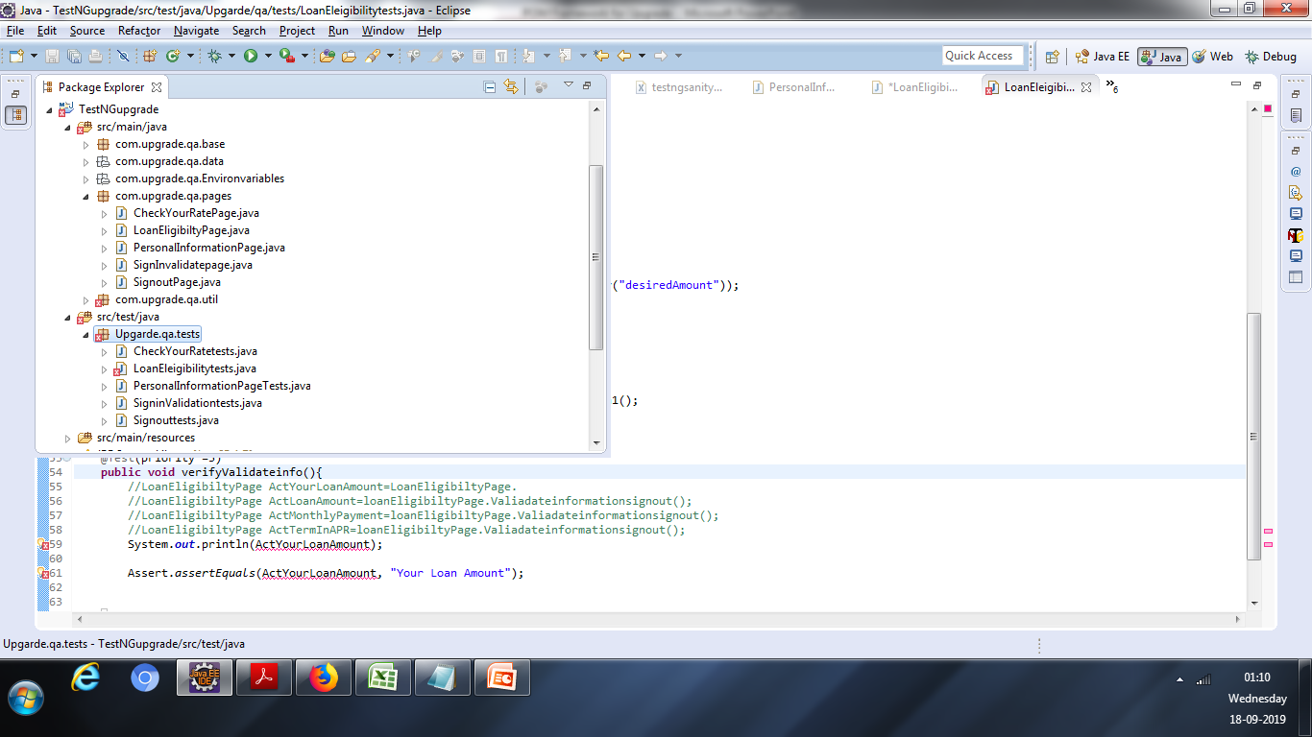
Upgrade project structure in eclipse

